Slide 1


Forecasting future house prices
Team members:
Mohamed Amine MKHAIBOU
Anna Lebedeff
Khoa Nugyen
Sami Valkamaa
Oriented by:
Mr. Jorma Laaksonen
Mr. Juha Vesanto
Mr. Roope Ruusuvuori

Slide 2


Presentation map
OP Project GOAL
Communication channels
Data sources
Format of data
Next steps

Slide 3
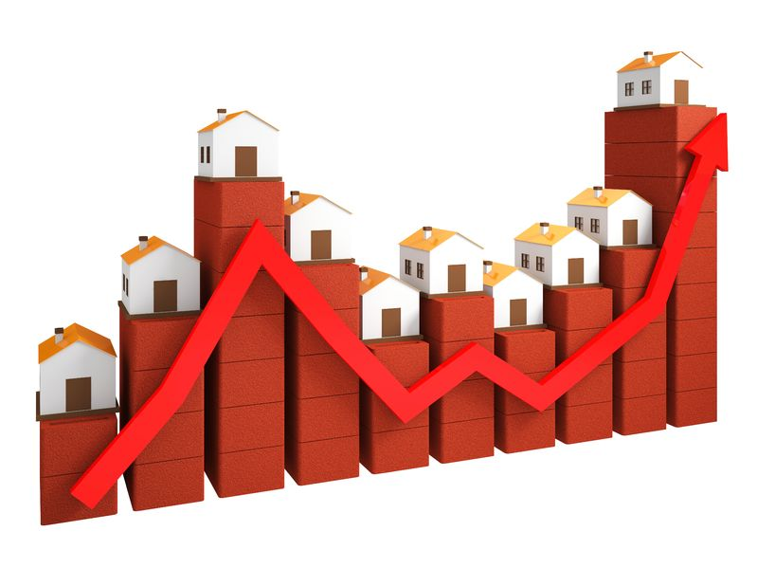
OP Project GOAL
Goal :
Predict housing prices one year from now => (end of 2021).
Requirements :
Ability to follow the development quarter-to-quarter => (Q1/2021, Q2/2021, Q3/2021, Q4/2021).
Ability to follow the development per region => Postal code / Province.
Ability to follow the development per type of housing => Flats (one-room flat, two-room flat, three-room flat+), row houses (Terraced houses).

Slide 4



Communication channels
Telegram
Google drive
Google Colab
Microsoft Teams

Slide 5

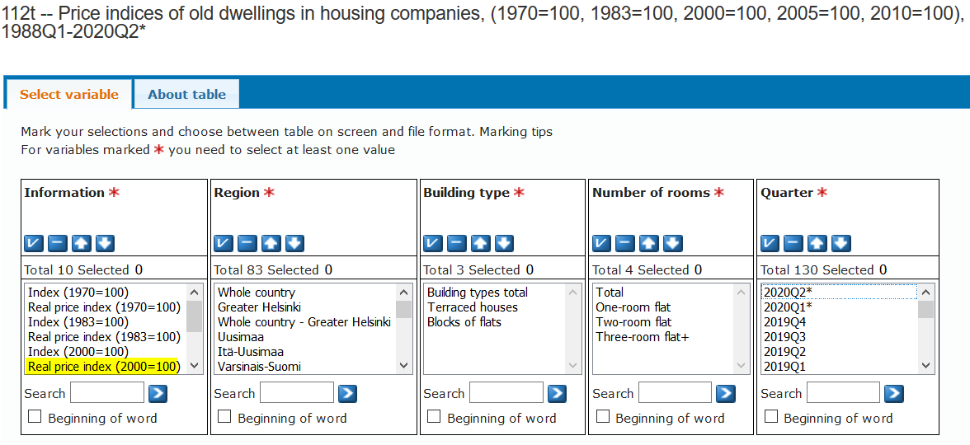
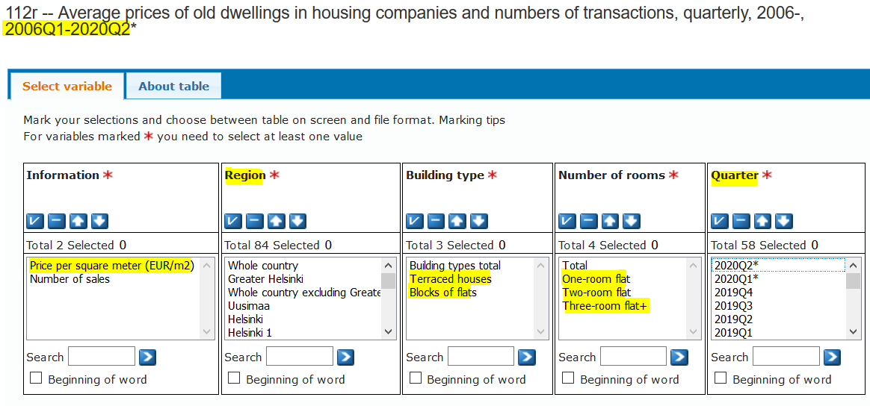
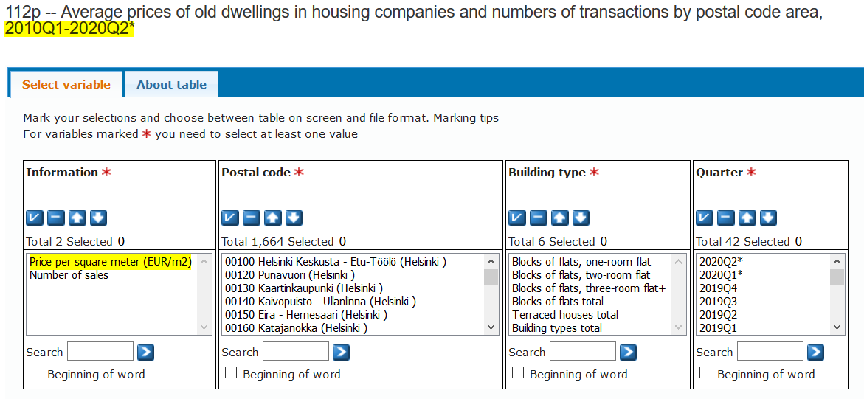

Data sources
Main source :
Tilastokeskus => Statistics Finland's PxWeb databases
Possible DBs :

Slide 6
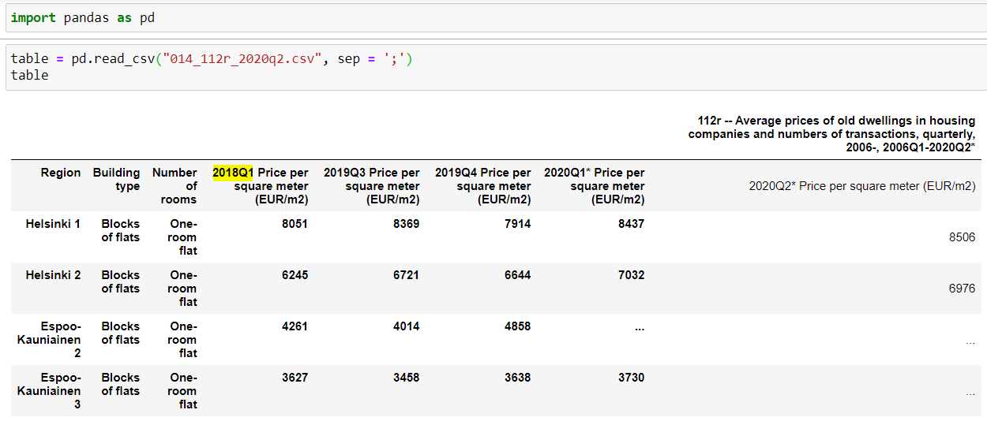
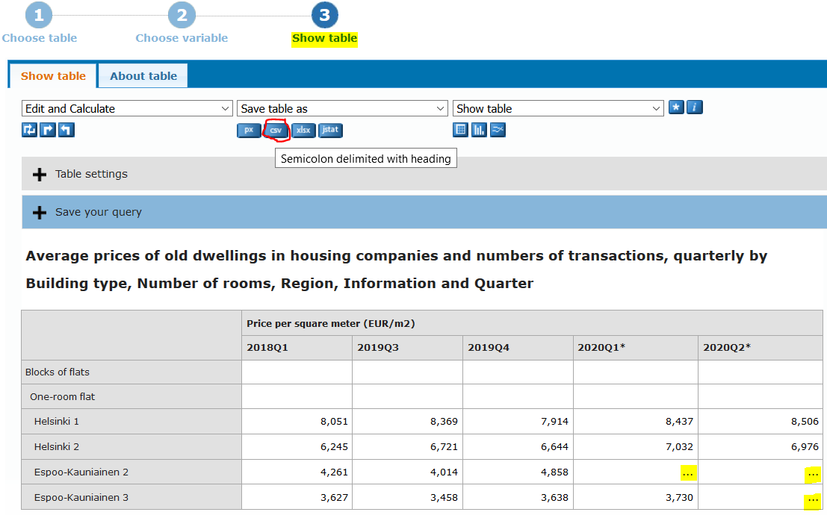
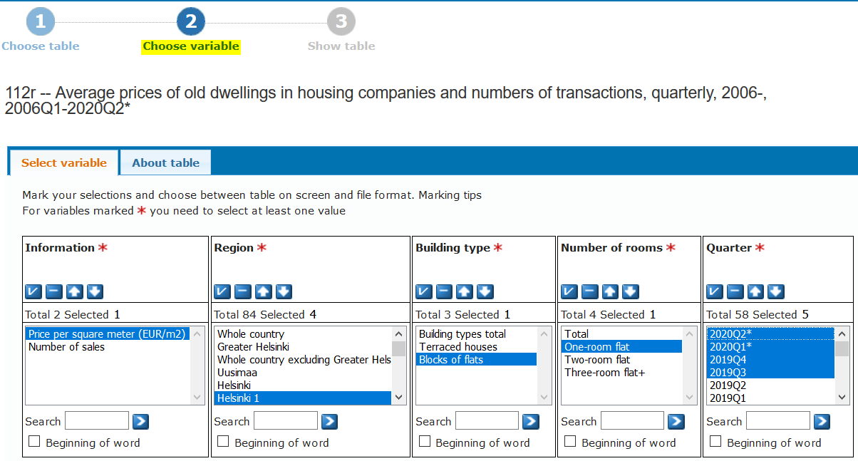
Format of data
Sequencing:
Choose the filters => Make an overview on results => Download the table as CSV file => Use the CSV file.

Slide 7

Next steps
Extract 4 DBs: Building type( Number of rooms )
Terraced houses (total);
Blocks of flats (one-room flat);
Blocks of flats (two-room flat);
Blocks of flats (three-room flat+);
Add the postal code of each region.
Perform an EDA (Explanatory Data Analysis) on each DB.
Preprocessing the data (Impute NA values, ..).
As we have a regression problem, we will try first the Linear regression model.

Slide 8

Thank you for your kind attention ☺

